Slide 1
Lecture 11: NoSQL Databases
Part 2
Mr. Hemanga Gautam
hemanga.gautam@heraldcollege.edu.np

Slide 2
NoSQL
MongoDB – Further querying

Slide 3
Why NoSQL?
Modern applications cover the include web, mobile and Internet of Things and have different characteristics to traditional enterprise applications.
They need to:
  Support large numbers of concurrent users (tens of thousands, perhaps millions)
  Deliver highly responsive experiences to a globally distributed base of users
  Be always available – no downtime
  Handle semi- and unstructured data
  Rapidly adapt to changing requirements with frequent updates and new features
New enterprise technology architecture needs to be agile and accommodate unprecedented levels of scale, speed and data variability
Companies are tuning to NoSQL database technology to achieve all of this.
Notes:
https://www.couchbase.com/resources/why-nosql

Slide 4
Who uses NoSQL?
Example Global 2000 enterprises that are using NoSQL for mission-critical systems:
  Tesco, Europe’s No.1 retailer, deploys NoSQL for e-commerce, product catalogue, and other applications
    https://www.couchbase.com/customers/tesco
  Ryanair, the world’s busiest airline, uses NoSQL to power its mobile app serving over 3 million users
    https://www.computerworlduk.com/data/ryanair-invests-in-nosql-mobile-platform-boost-customer-experience-3605335/
  Marriott deploys NoSQL for its reservation system that books $38 billion annually
    https://diginomica.com/2015/10/07/why-marriott-is-transforming-their-legacy-systems-with-nosql/
  Gannett, the No.1 U.S. newspaper publisher, uses NoSQL for its proprietary content management system, Presto
    https://www.couchbase.com/customers/gannett
Notes:
https://dataconomy.com/2014/02/tesco-pioneers-big-data/

Slide 5
NoSQL Databases
Unlike relational databases there are 4 different flavours of NoSQL
  Key-value store
  Document-based store
  Column-based store
  Graph-based
Couchbase and MongoDB are some of the most popular document based databases
Notes:
https://www.3pillarglobal.com/insights/exploring-the-different-types-of-nosql-databases

Slide 6
MongoDB Reminder
Document
  A document is a set of key-value pairs:
  {
  studentno: 1712345,
  studentName: “Anton Du Beke”,
  email: “a.dubeke@wlv.ac.uk”
  }
  Documents have a dynamic schema, which means that documents in the same collection do not need to have the same set of columns or structure.
  {
  studentno: 1754321,
  studentName: “Susan Calman”,
  dob: “11-APRIL-1999”
  email: “s.calman@wlv.ac.uk”
  }
  Common fields in a collection's documents may hold different types of data too.
  {
  studentno: 1754321,
  studentName: { firstName: “Kevin”, surname: “Clifton” },
  email: “k.clifton@wlv.ac.uk”
  }
value
key
DOB is new
studentName now an array

Slide 7
Using MongoDB – Collections
If a collection does not exist, MongoDB will automatically create the collection when you first store data for that collection.
To create a new collection:
  db.createCollection('depts', {max: 20})
  This creates a collection called depts that can hold a maximum of 20 documents.
To show what collections you have:
  show collections

Slide 8
Using MongoDB – Documents
Data is stored as BSON documents in a collection.
  BSON is a binary representation of JSON documents.
JSON is built on two structures:
  A collection of name/value pairs
  An ordered list of values, such as an array
To add new data, involves the use of the INSERT command:
    db.collectionName.insert( {
    key1: 'value1',
    keyN: valueN } )
This is similar to an INSERT statement in SQL, where the collectionName would be the table and the key is the column and the value is the data to be stored.
For example (SQL):
  INSERT into collectionName (key1, keyN)
  VALUES (‘value1’, ‘valueN’);

Slide 9
MongoDB – Documents
Unlike the relational model, you do not need to define a schema in advance for our documents, with the equivalent of a CREATE TABLE statement.
In fact the structure of the documents can change from one document to another.
This is why it is referred to as being schema-less.
In reality, most collections would contain documents of a similar type, e.g., a collection of student information.

Slide 10
Object Ids
MongoDB creates a unique object id for objects in the database.
For example:
  db.dept.find()
  Will show an object id for each department document, along the lines of:
  "_id" : ObjectId("58245944d6473dc2e8d23a26")
This is a system generated, but you can define your own object ids too (like a primary key)
For example:
  db.projCollection.insert( {
  _id: 10,
  projno: 110,
  proj_name: 'Oracle Project',
  budget: 10000 } )
db.projCollection.insert( {
projno: 140,
proj_name: 'ObjectId Project',
budget: 25000 } )
Or omitting an _id generates a system id

Slide 11
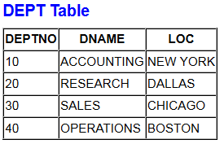
Collection Example: Dept
To create the equivalent of our Dept table:
    db.dept.insert( [
    {
    _id: 10,
    deptno: 10,
    dname: "ACCOUNTING",
    loc: "NEW YORK"
    } ,
    {
    _id: 20,
    deptno: 20,
    dname: "RESEARCH",
    loc: "DALLAS"
    ] })
Use square brackets to add more than one record
Object identifier
Character data must be in double quotes

Slide 12
Queries
Collections can be queried using the find() method.
The basic syntax is:
    db.collectionName.find()
This will return the data in an unstructured way.
To improve this, use the pretty() method:
      db.collectionName.find().pretty()
For example:
    db.dept.find().pretty()

Slide 13
find()
find() can also contain parameters to restrict what data is returned
  Similar to the WHERE part of a SQL statement
For example, to find the Sales department details:
  db.dept.find({dname:"SALES"})
Produces:
  { "_id" : 30, "deptno" : 30, "dname" : "SALES", "loc" : "CHICAGO" }
Find the employees in department 30:
  db.emp.find({deptno:30})

Slide 14
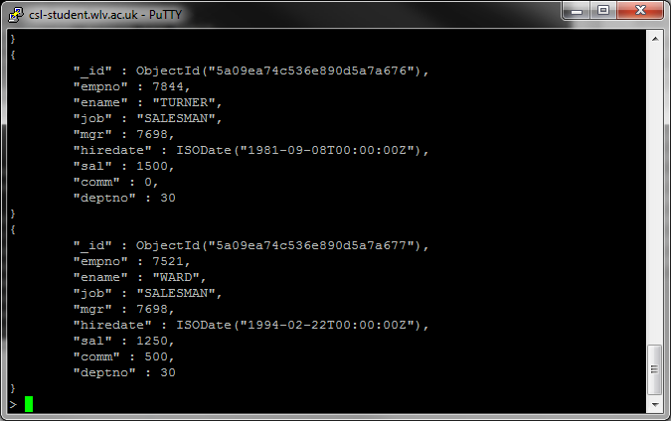

Slide 15
find()
Note: everything is case sensitive!
  The following will return nothing:
    db.dept.find({DNAME:"SALES"})
    db.DEPT.find({dname:"SALES"})
    db.dept.find({dname:"sales"})
  And these will return an error message:
    DB.dept.find({dname:"SALES"})
    db.dept.FIND({dname:"SALES"})
column names can be in double quotes too:
  db.dept.find({"dname":"SALES"})
Notes:
db.dept.find({DNAME:"SALES"}) – DNAME in capitals
db.DEPT.find({dname:"SALES"}) – DEPT in capitals
db.dept.find({dname:"sales"}) – sales in lower case
DB.dept.find({dname:"SALES"}) – DB is not recognised
db.dept.FIND({dname:"SALES"}) – FIND is not a function

Slide 16
find()
Other examples of using find:
Operation | Syntax | Example | RDBMS Equivalent
Equality | {<key>:<value>} | db.dept.find({loc:"NEW YORK"}) | where loc= ‘NEW YORK'
Less Than | {<key>:{$lt:<value>}} | db.dept.find({deptno:{$lt:30}}) | where deptno < 30
Less Than Equals | {<key>:{$lte:<value>}} | db.dept.find({deptno:{$lte:30}}) | where deptno <= 30
Greater Than | {<key>:{$gt:<value>}} | db.dept.find({deptno:{$gt:30}}) | where deptno > 30
Greater Than Equals | {<key>:{$gte:<value>}} | db.dept.find({deptno:{$gte:30}}) | where deptno >= 30
Not Equals | {<key>:{$ne:<value>}} | db.dept.find({deptno:{$ne:30}}) | where deptno != 30
https://www.tutorialspoint.com/mongodb/mongodb_query_document.htm

Slide 17
$group
Similar to SQL command:
SELECT deptno, SUM(sal) AS total
FROM emp
GROUP BY deptno;
$group will take the input document and group them by a specified key and then apply the aggregate function to each group
For example, suppose we want to sum the salaries found in the emp collection:
  db.emp.aggregate ( [
  { $group:
  { _id: “$deptno", total: {$sum: "$sal"} } }
  ])
Aggregate operator
Key (column) to be processed
Key (column) we want to group by
Name for the result
Aggregate function
Notes:
https://docs.mongodb.com/manual/reference/operator/aggregation/#aggregation-pipeline-operator-reference

Slide 18
Aggregation Pipeline
More complex queries require the use of a framework called the aggregation pipeline
At the start of the process is the collection, which is searched document by document
Documents are piped through a processing pipeline and go through a series of stages until you get a result set
http://www.c-sharpcorner.com/article/aggregation-pipeline-in-mongodb/
Notes:
Can’t use $filter by itself

Slide 19
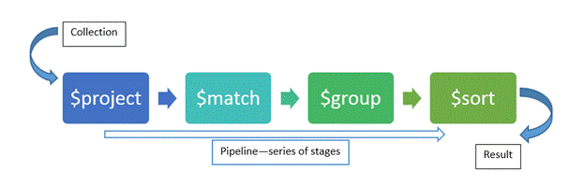
Aggregation Pipeline

Slide 20
Aggregation Pipeline
This is needed if you want to compute results on the data, such as sum or count
  Similar to using GROUP BY in SQL
Each stage in the pipeline transforms the documents as they pass through the pipeline.
A basic pipeline provides filters that are like queries and document transformations that modify the form of the output.
  https://docs.mongodb.com/manual/reference/operator/aggregation/
Notes:
https://docs.mongodb.com/manual/reference/operator/aggregation/

Slide 21
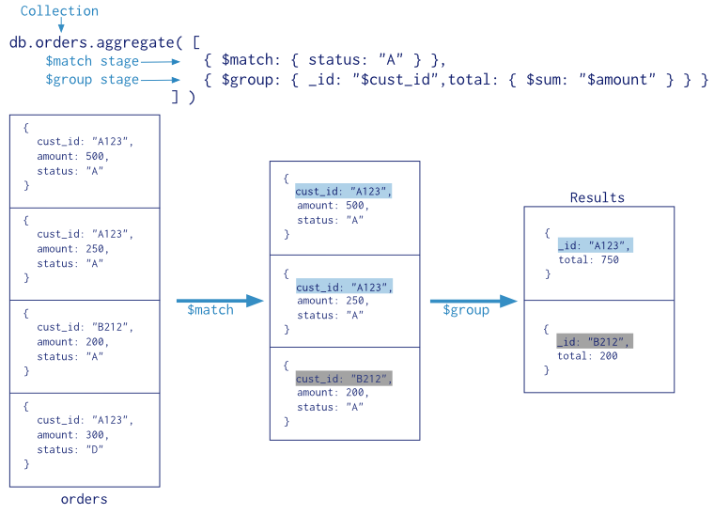
Pipeline Example
document transformations
Similar to SQL statement:
SELECT cust_id, SUM(amount)
FROM orders
WHERE status = ‘A’
GROUP BY cust_id
https://docs.mongodb.com/manual/core/aggregation-pipeline/

Slide 22
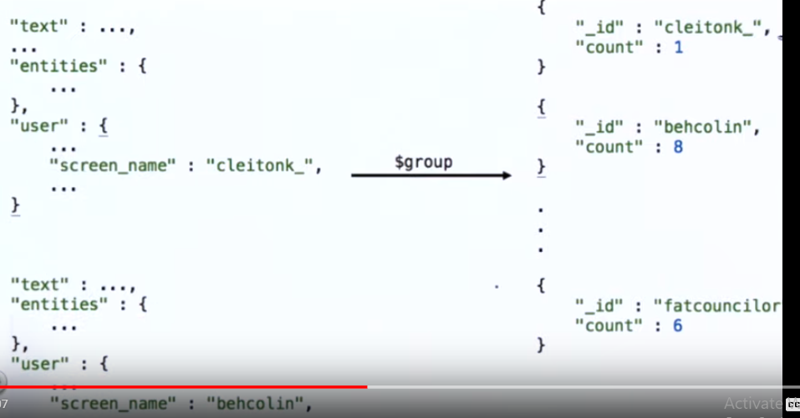

Slide 23
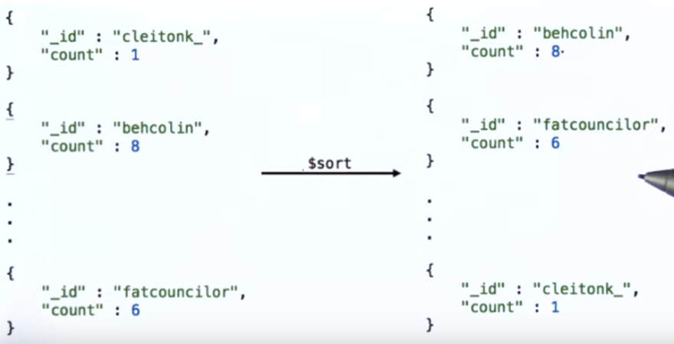

Slide 24
Other functions: count and distinct
count can be used to count the number of documents in a collection:
  db.emp.count()
Can also provide a query to apply a selection criteria:
    db.emp.count({deptno: 10})
Can also add count() to a find query to count the records returned, instead of listing them:
  db.dept.find({dname:"SALES"}).count()
distinct finds the distinct values for a specified column (similar to distinct clause in SQL):
  db.emp.distinct("deptno")

Slide 25
Nested documents

Slide 26
DEPT/EMP schema
Instead of having two separate tables, the employee details can be nested within the department:
  db.deptCollection.insert(
  { deptno: 10,
    dname: 'ACCOUNTING',
    loc: 'NEW YORK',
    employees: [
    { empno: 7782,
    ename: 'CLARK',
    job: 'MANAGER',
    sal: 2450
    },
    { empno:7839,
    ename: 'KING',
      job: 'PRESIDENT',
      sal: 5000
      },
    ]
} )
Set of employees, stored as a array

Slide 27
Finding data in nested documents
Finding data in a nested document is more complex.
Need to use dot notation to refer to the nested fields, such as employees.sal
  db. deptCollection.find( { "employees.sal" : { $gt: 2000}})
employees is an array of employee type.
Will return all the employees in the document, even if only one employee found with this criteria!

Slide 28
Pattern Matching
When analysing data you might not want to search for an exact value
Regular expressions can be used to search for patterns in the data
Similar to SQL’s LIKE clause
The format for regular expressions is:
  { <field>: /pattern/<options> }
Or can use the $regex command:
  { <field>: { $regex: /pattern/<options> } }

Slide 29
Pattern Matching Examples
For example:
  db.dept.find({dname: /SAL/})
  db.dept.find({dname: { $regex: /^RES/}}) //strating form RES
  db.dept.find({dname: { $regex: /RES/}}) //RES contain garne sapai
Use i option to make it case insensitive:
  db.emp.find({ename:/sco/i})
Nested queries:
  db.deptCollection.find( {"employees.ename":/sco/i} ).pretty()
  //returns employee names within employees array which contains strictly lowercase sco

Slide 30
$filter & Nested Documents
It is not satisfactory to return all the employees in the array if only 1 record matches
employees is an array, which has various operators such as: $filter
  This returns a subset of the array with only the elements that match the filter condition
  We can use this to “gather” elements of our employees array to get the employees matching the query criteria only, rather than one, or everyone.

Slide 31
$filter
$filter has the following syntax:
  { $filter: {
  input: <array>, /* expression for the array */
  as: <string>, /* variable name for the element */
  cond: <expression> /* filter condition */
  } }
For example:
  db.deptCollection.aggregate([ {
  $project: { /* used to pass along the documents to the next stage */
  empSet: { /* name for the aggregated set */
  $filter: {
  input: "$employees",
  as: "employee",
  cond: { $gte: [ "$$employee.sal", 2000 ] }
  } /* filter */
  } /* empSet */
  } /* project */
  } /* aggregate */
  ]) /* Lots of brackets to match up! */
Notes:
http://www.sanfoundry.com/mongodb-questions-answers-aggregation-pipeline/

Slide 32
$lookup
$lookup can be used to provide a left outer join between two collections.
The $lookup stage does an equality match between a column from the input documents with a column from the joined collection:
Collection providing input documents
Similar to SQL command:
SELECT * FROM
dept, emp
WHERE dept.deptno = emp.deptno;
  db.dept.aggregate([ {
  $lookup: {
  from: "emp",
  localField: "deptno",
  foreignField: "deptno",
  as: "employees"
  }
  }
  ])
Collection to join
Column to match in the dept collection (PK)
Column to match in the emp collection (FK)
Name for the output array

Slide 33
JSON and Relational databases
A lot of systems will now use JSON format for data exchange, so increasingly relational databases are offering support to handle JSON data.
For example, Oracle 12c V2 allows JSON columns:
  CREATE TABLE dept_json(
  deptno NUMBER(2) NOT NULL,
  dname VARCHAR2(15),
  emp_doc CLOB CONSTRAINT ensure_json
  CHECK (emp_doc IS JSON));
Inserts:
  INSERT INTO dept_json
  VALUES (10, 'ACCOUNTING',
  '{ "empno" : 7782,
  "ename" : "CLARK",
  "contactDetails" : {"phoneExt" : 1483, etc...}’);
Querying nested values using dot notation:
  SELECT d.emp_doc.contactDetails.phoneExt
  FROM dept_json d;
Notes:
https://docs.oracle.com/database/121/ADXDB/json.htm#ADXDB6252

Slide 34
NoSQL V’s Relational

Slide 35
NoSQL V’s Relational
Does these NoSQL systems mean the end of relational DBMS?
No quite, relational DBMS are still appropriate for structured data.
However, we are entering an age of “polyglot persistence”
  This is a technique that uses different data storage technologies to handle varying data storage needs.
  Polyglot persistence can apply across an enterprise or within a single application.
Notes:
https://www.mapr.com/products/polyglot-persistence
http://www.mohawksoft.org/?q=node/63

Slide 36
Why NoSQL Will Not Kill the RDBMS
There seems to be three major focuses of the NoSQL movement (Mohawksoft.org):
  scalability of storage
    All systems (including NoSQL) will hit limitations when you increase the load
    The strategy of NoSQL is to create a system that can easily grow beyond any “current” implementation should the need arise.
  rigid schemas
    Most data does not fit easily into a normalised schema
  non-scalability of relational data access
    “joins don't scale”
    Joining tables will be less efficient than reading from a data store
Notes:
http://www.mohawksoft.org/?q=node/63
Also see:
https://asktom.oracle.com/pls/asktom/f?p=100:11:0::::P11_QUESTION_ID:2664632900346253817

Slide 37
Why NoSQL Will Not Kill the RDBMS – Rebuttal: Scalability
“Scalability” is a difficult problem to quantify - what should be scaled?
The big problem:
  quantifying what you want to scale:
    data storage, like a remote backup service?
    small transactions like twitter?
    mostly page views like Google?
  What is your ratio between reads and writes?
  What kind of information does your site serve?
  How coherent must your data be? Do you need to guarantee data integrity?
To have any meaningful discussion on scalability, you need to quantify what it is you wish to scale and the limitations imposed by requirements.
Don’t forget RDBMS databases can be scaled with faster hardware, data partitioning, better caching, and etc.

Slide 38
Why NoSQL Will Not Kill the RDBMS – Rebuttal: Rigid Schemas
Even in the most “schemaless” database, there is structure in the way the data is stored
  How would the system access it otherwise?
  If we accept that there must be some order and control over the data storage, whether or not we call it a schema is unimportant.
SQL “schemas” are not inflexible
  One can add and usually remove columns in a SQL table.
Could create “generic” key/value tables in a standard SQL database where the “value” column contains any sort of data.
In NoSQL solutions which do not enforce a data definition, you can not search by data contained in “value,” so how is the SQL implementation any different?
  In addition, many SQL databases allow you to create an index based on the results of a function.
  If the “value” in your key/value table contains something like XML or JSON, you can create an index from specific member values extracted from a parser function.

Slide 39
Why NoSQL Will Not Kill the RDBMS – Rebuttal: Joins
A SQL RDBMS is a comprehensive set of tools, it does not require that data be 100% normalized.
Just because an RDBMS supports joins, triggers, foreign key constraints, primary keys and so on, does not mean that you need to use them.
You design your system for your needs.
  If you don't want a join, put all your data in one table.
  You want a key/value store? Create a key/value table:
    CREATE TABLE myKeyValue (
      key NUMBER(5),
      Value XMLType ); /* or could be BLOB, or CLOB */
You still get all the tools and features of the RDBMS if you need them.
In a NoSQL system, you don't have that option.

Slide 40
External Found Data
For this module we are concerned with manipulating found data rather than creating new MongoDB documents
For example, Twitter data is in JSON format, which can be manipulated using MongoDB.
Many webpages that advocate using JSON over XML:
  https://www.quora.com/What-are-the-advantages-of-JSON-over-XML
  https://www.programmableweb.com/news/xml-vs.-json-primer/how-to/2013/11/07
  https://www.sitepoint.com/json-vs-xml/
  https://www.w3schools.com/js/js_json_xml.asp
Consensus is it is seen as being simpler

Slide 41
Conclusion
NoSQL
  Lots of different types of projects.
  Many of the examples listed are open-source.
  The fact there is no well-defined definition could lead to its downfall.
  RDBMS could evolve to provide better support for non-structured data.
Horses for courses
  Need to appreciate the strengths and weaknesses of each type of database, so you can pick the most appropriate tool for the data being stored

Slide 42
References
Lecture slides from Level 6 (Big Data) of WLV

